Slide 1
IBM Capstone Project
Business Consultancy for Property Developers to Open a Shopping Mall
By
Saad Muhammad

Slide 2
Business Problem & Audience
Opening a shopping mall requires huge amount of financial resources as well as time. To make a shopping mall a success, the choice of its location can play a vital role.
Use data science to address the problem of deciding the best location in the city of Karachi to open a Shopping Mall
The audience of this project will be the property developers who are interested in opening a shopping mall in Karachi

Slide 3
Data Required & Source
List of all the neighborhoods in Karachi
Geocoordinates of against all the neighborhoods
And finally the venues in the neighborhoods
Source: https://en.wikipedia.org/wiki/Category:Neighbourhoods_of_Karachi

Slide 4
Methodolgy
Data collection
Data cleaning
Retrieve and plot geocoordinates against neighborhoods
Use FourSqaure to get the list of venues against neighbourhoods
Filter venues to select shopping malls in Karachi
Use K-Means to cluster the shopping malls
Visualize and cluster using Folium
Make recommendations

Slide 5
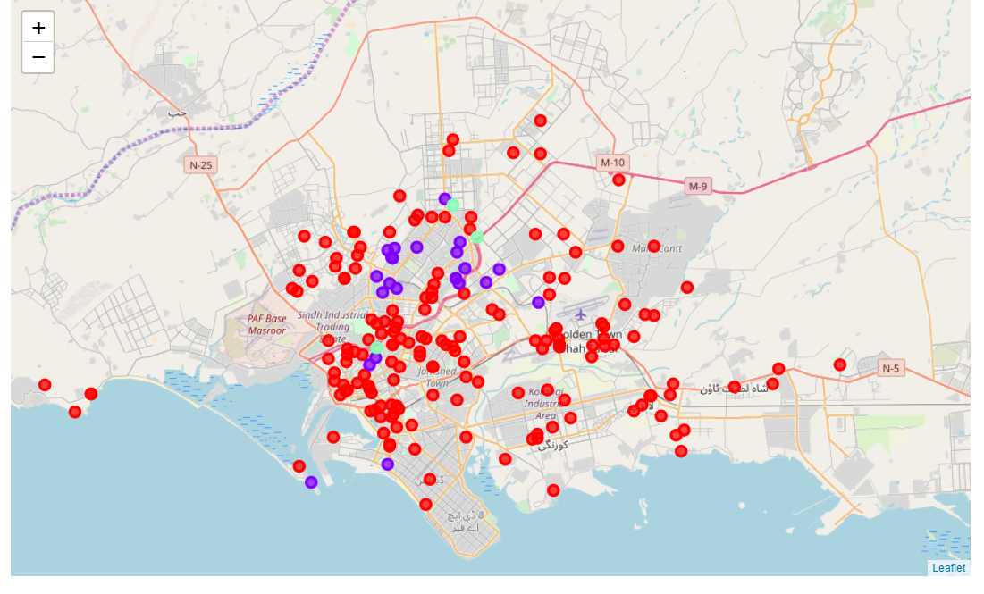
results
We have used K-Means to cluster the shopping malls in the city Cluster 0: Neighborhoods with no shopping malls and is represented with red circles on the map Cluster 1: Neighborhoods with high concentration of shopping malls and is represented with purple circles on the map Cluster 2: Neighborhoods with low concentration of shopping malls and is represented with mint circles on the map

Slide 6
recommendation
There is little information available on cluster0 about the wealth profile of the neighborhoods, there may be slums and low income neighborhoods in this cluster and therefore not recommended for opening a shopping mall.
Cluster 1 is composed of middle to high income neighborhoods, considering these neighborhoods may be a little risky but it would surely be rewarding at the same time because of greater foot fall and awareness in the neighborhood and is recommended for risk taking developers
Cluster2 and its surrounding neighborhoods would be a good choice to open shopping malls and is recommended for risk averse developers

